Slide 1







Real Estate Price Forecasting
A MACHINE LEARNING APPROACH TO PREDICTING PROPERTY PRICES ACCURATELY

Slide 2







Team Members
Rwan Taha
Asmaa Gamal
Sara Ashraf
Mohamed Abdelhamid

Slide 3
Table of Content
1
2
3
Problem Statement
Project Objectives
Dataset Overview
4
5
6
Data Cleaning & Preprocessing
Exploratory Data Analysis (EDA)
Visualization
7
8
9
Modeling & Evaluation
Streamlit Web App
Final Results & Observations
10
Q&A

Slide 4

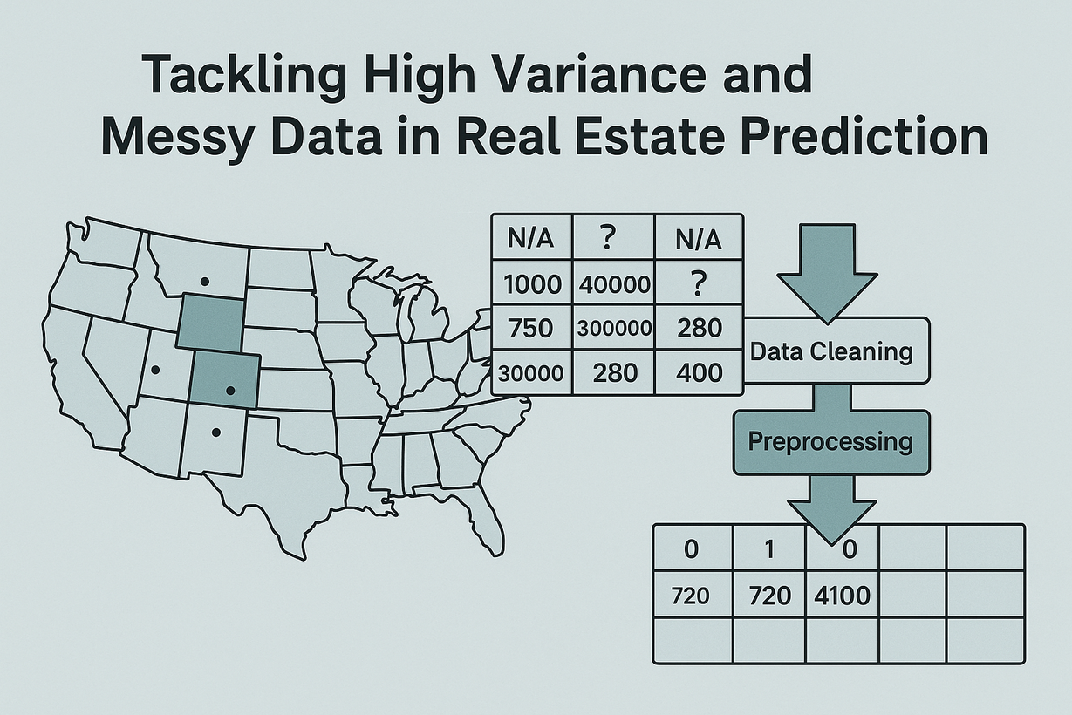
Manually generated dataset .
not Kaggle-ready
Problem Statement
Difficulty in comparing similar properties
Inaccurate property valuations
The goal is to create a reliable, data-driven solution that predicts property prices with higher accuracy.

Slide 5




Project Objectives
Clean and preprocess the dataset
Perform Exploratory Data Analysis (EDA)
Build a Machine Learning model
Develop an interactive web application
TO HANDLE MISSING VALUES, OUTLIERS, AND ENCODE CATEGORICAL VARIABLES
TO UNDERSTAND FEATURE DISTRIBUTIONS AND RELATIONSHIPS.
TO PREDICT REAL ESTATE PRICES ACCURATELY BASED ON PROPERTY FEATURES
USING STREAMLIT FOR USERS TO EXPLORE DATA, RUN PREDICTIONS, AND VIEW VISUALIZATIONS.

Slide 6
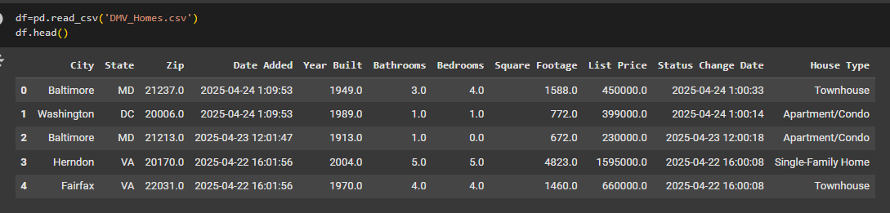
Dataset Description
SOURCE: ZILLOW
SIZE: ~5,500 ROWS
FEATURES:
USE CASE: PREDICTING HOUSE PRICES BASED ON PROPERTY ATTRIBUTES

Slide 7

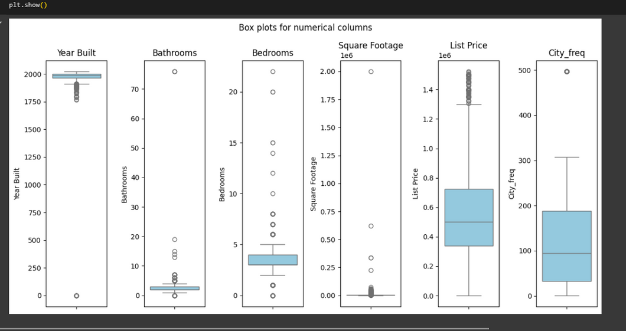
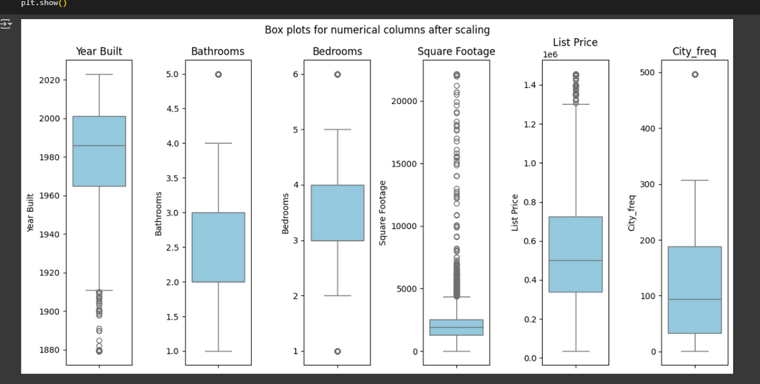
Data Cleaning & Preprocessing
Missing & Duplicated Values Handling
There were 1508 missing values in the dataset.
Numerical features: filled using median
Categorical features: filled using mode
there were 507 duplicate rows in the dataset.
Outliers Before & after Scaling
Categorical Encoding:
Applied Label Encoding for State, House Type
use frequency encoding and creat a new column "City_freq"
Data Splitting
Train/Test split: 80% training – 20% testing

Slide 8
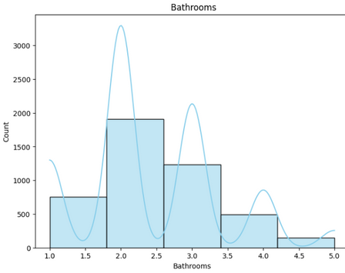
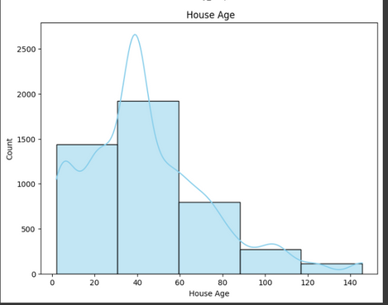
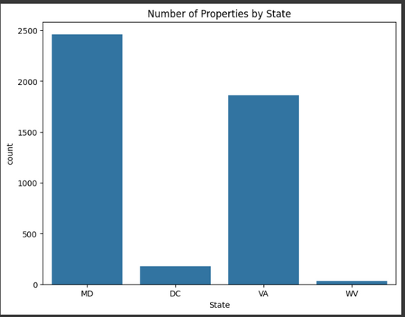
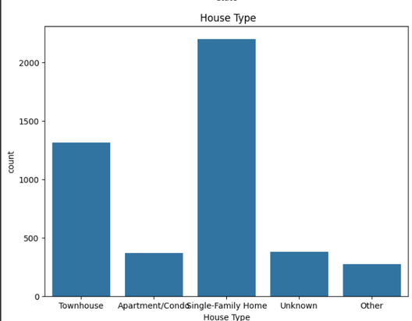
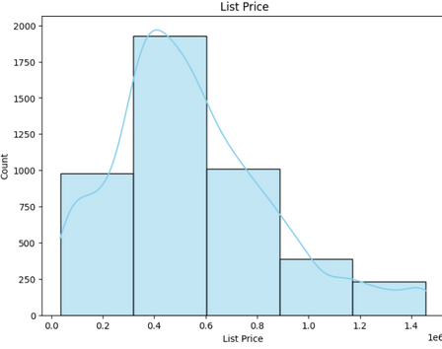
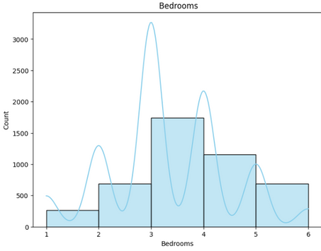
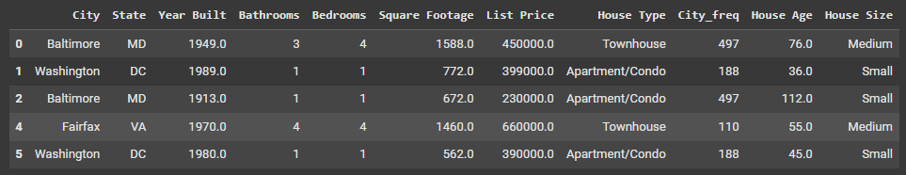
Exploratory Data Analysis (EDA)
Numerical Features
Categorical Features
Based on the EDA,
additional features were engineered to enrich the dataset and improve model performance, including:
1- City Frequency – representing how common each city appears
2-House Age – derived from the year built
3- House Size –Binned into categorical ranges

Slide 9

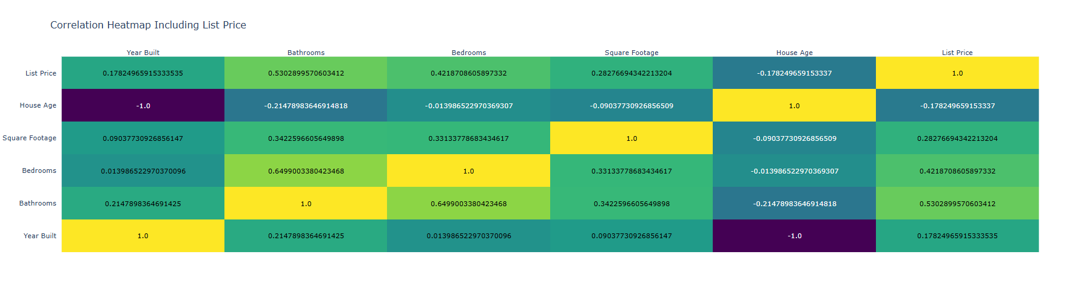
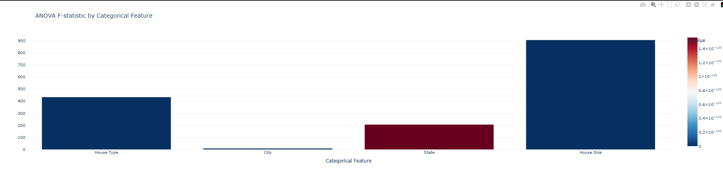
Visualization
Relation Between Numerical Features and The Target (The Price)
OBSERVATION
--Bathrooms and Bedrooms show the strongest positive correlations with List Price.
Relation Between Categorical Features and The Target (The Price)
OBSERVATION
--House Size has the strongest influence on List Price,
followed by State, then City.

Slide 10
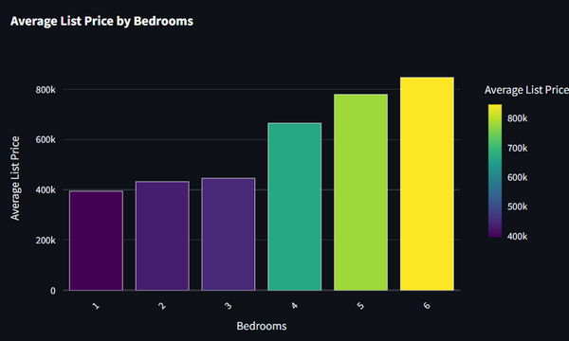
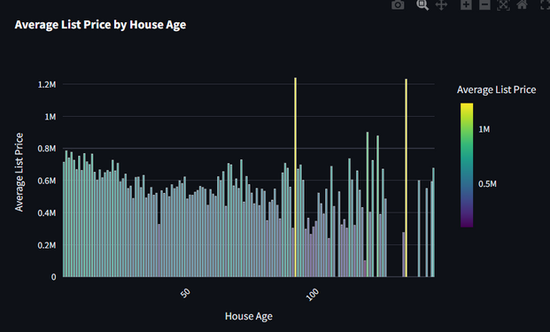
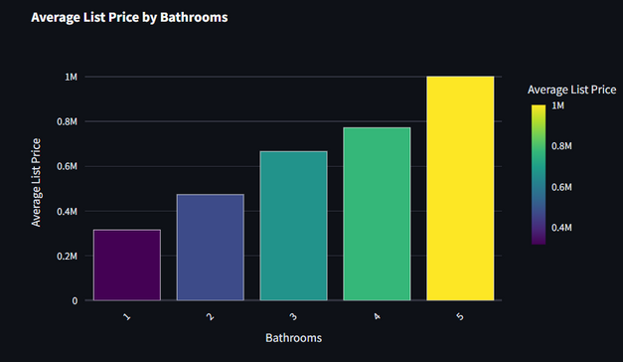
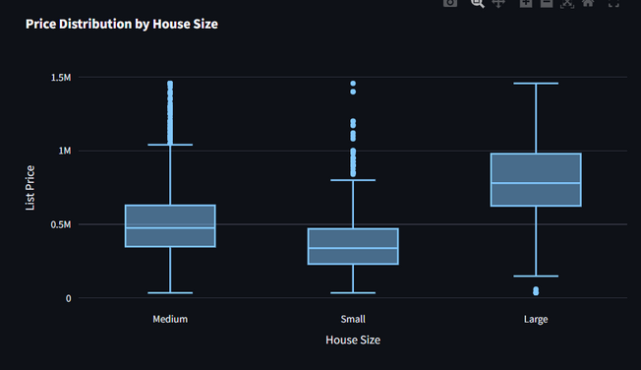
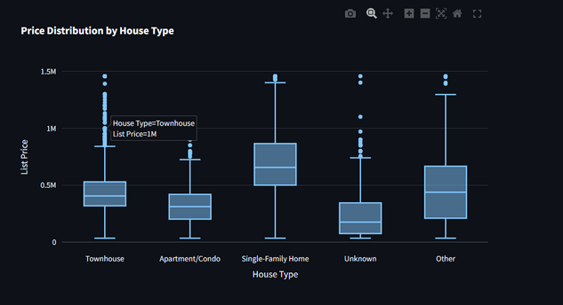
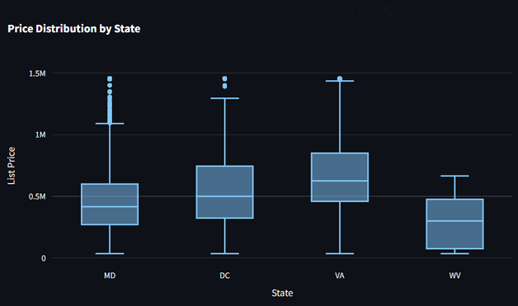
Visualization
Relation Between Numerical Features and The Target (The Price)
OBSERVATION
* Bathrooms – 5
→ Houses with 5 bathrooms have an average list price of $1,000,247, which is the highest among all bathroom counts.
*Bedrooms – 6
→ Properties with 6 bedrooms have the highest average price of $846,249.
* House Age – 92 years
→ Homes that are 92 years old (built around 1933) also have the same high average price as seen in Year Built.
Relation Between Categorical Features and The Target (The Price)
OBSERVATION
House Size: larger house sizes show a wider price range and more outliers
State North VA and DC have the highest prices
House Type: Single-family home has a great impact on the price

Slide 11

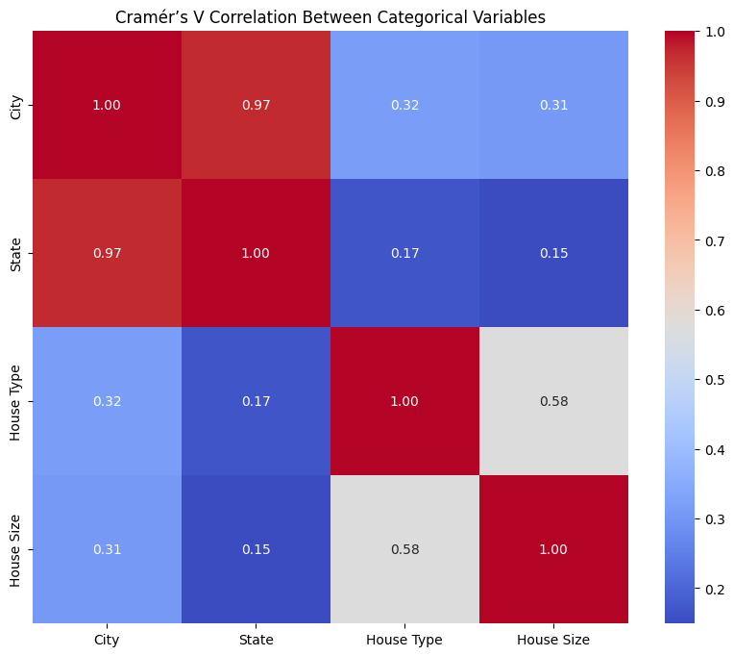
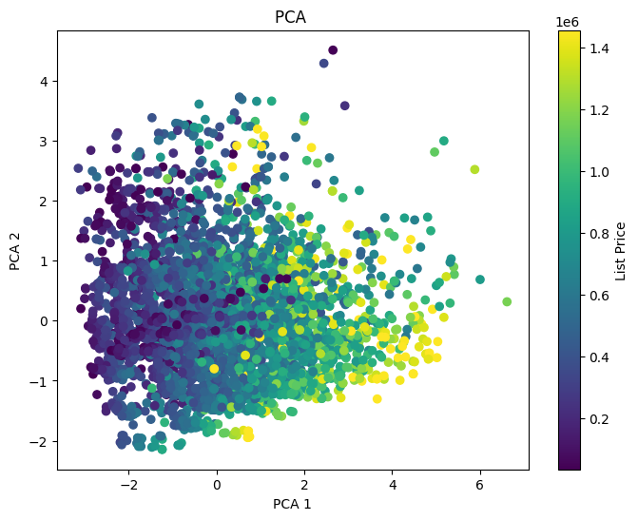
Statistical Analysis
Cramér’s V helped detect relationships between categorical features. The heatmap shows that some variables are strongly related and may need to be simplified to reduce redundancy.
PCA helped reduce 5 features into 2 main components while keeping most of the data's variance. The plot shows how properties are grouped based on price, which reveals hidden patterns.

Slide 12
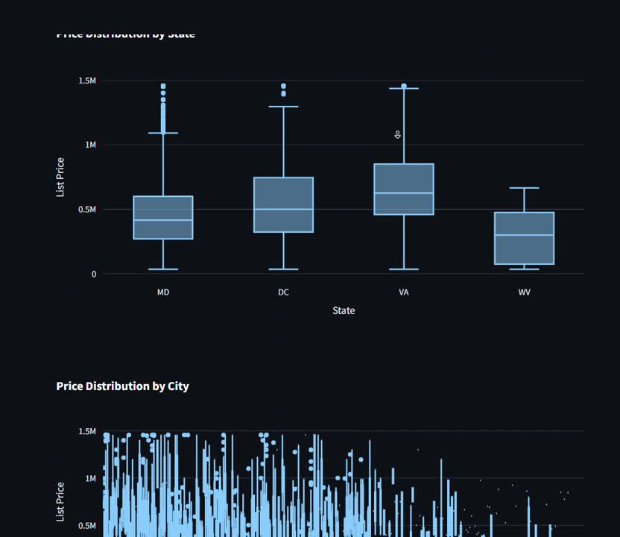
Visualization & Statistics
In Streamlit App

Slide 13
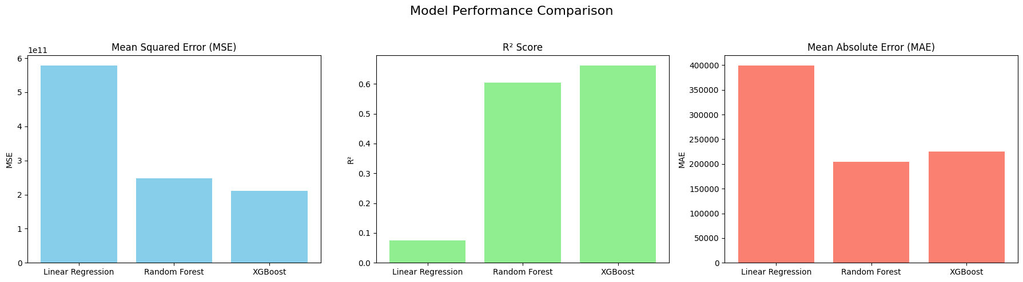
Modeling & Evaluation
XGBoost performed best with the lowest errors and highest R².
Linear Regression had the weakest performance.
Random Forest showed solid results, better than Linear Regression but behind XGBoost.

Slide 14
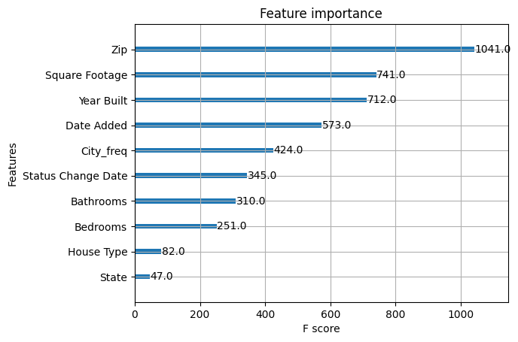
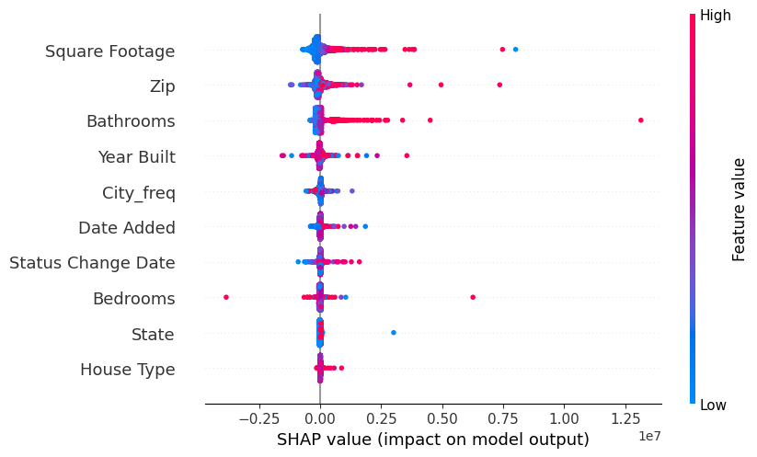
Modeling & Evaluation
The SHAP beeswarm plot provides a detailed view of how each feature influences individual predictions. It shows both the magnitude and direction of impact
feature importance plot from the XGBoost model highlights which variables contribute the most

Slide 15
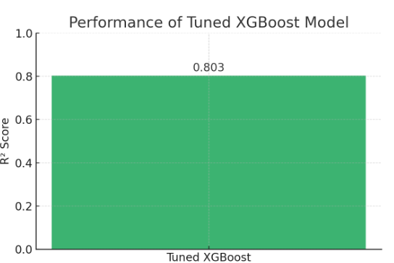

Modeling & Evaluation
The tuned XGBoost model achieves an R² score of 0.803, meaning it explains over 80% of the variance in the target variable.

Slide 16
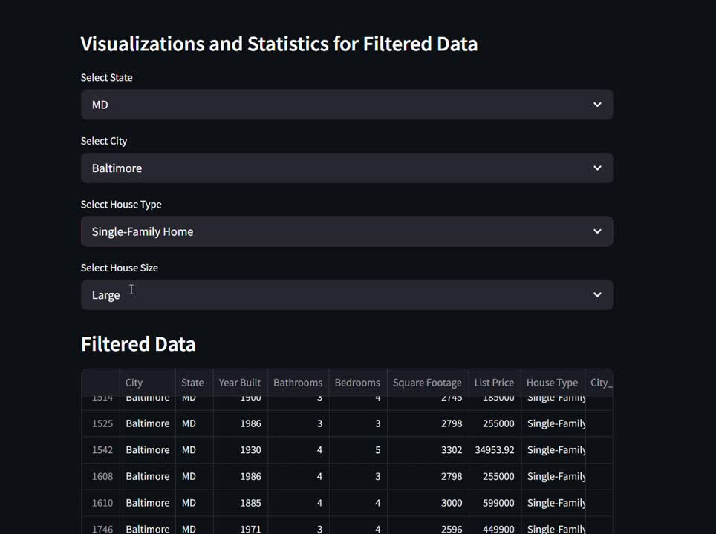
Streamlit Web App

Slide 17
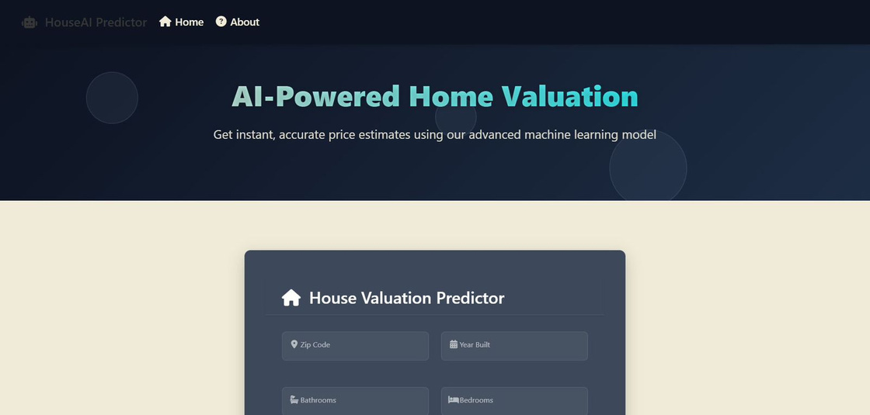
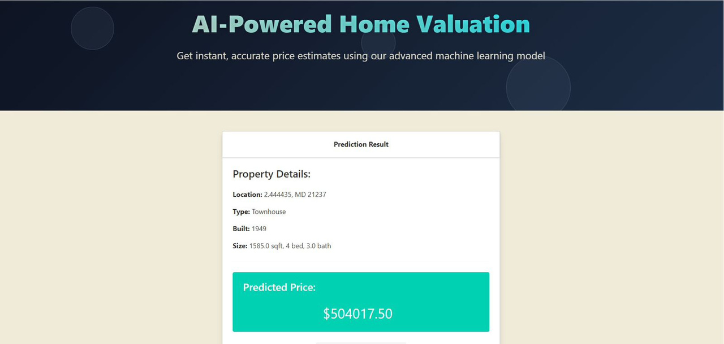

Deployment
Django web app features:
Using user friendly , easy interface
Username & Password: For each user to securely save their data and predictions.
Data Retrieval: Users can download their data as a CSV file or view it on the website.
- ⁠sqllite db for fast data save & retrieve

Slide 18
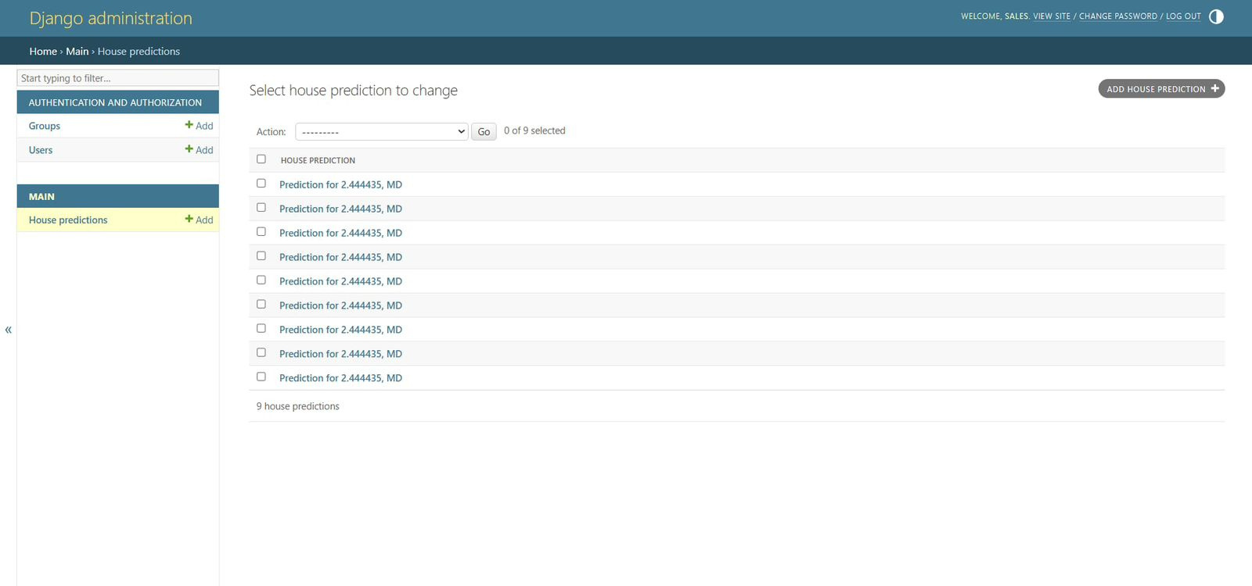
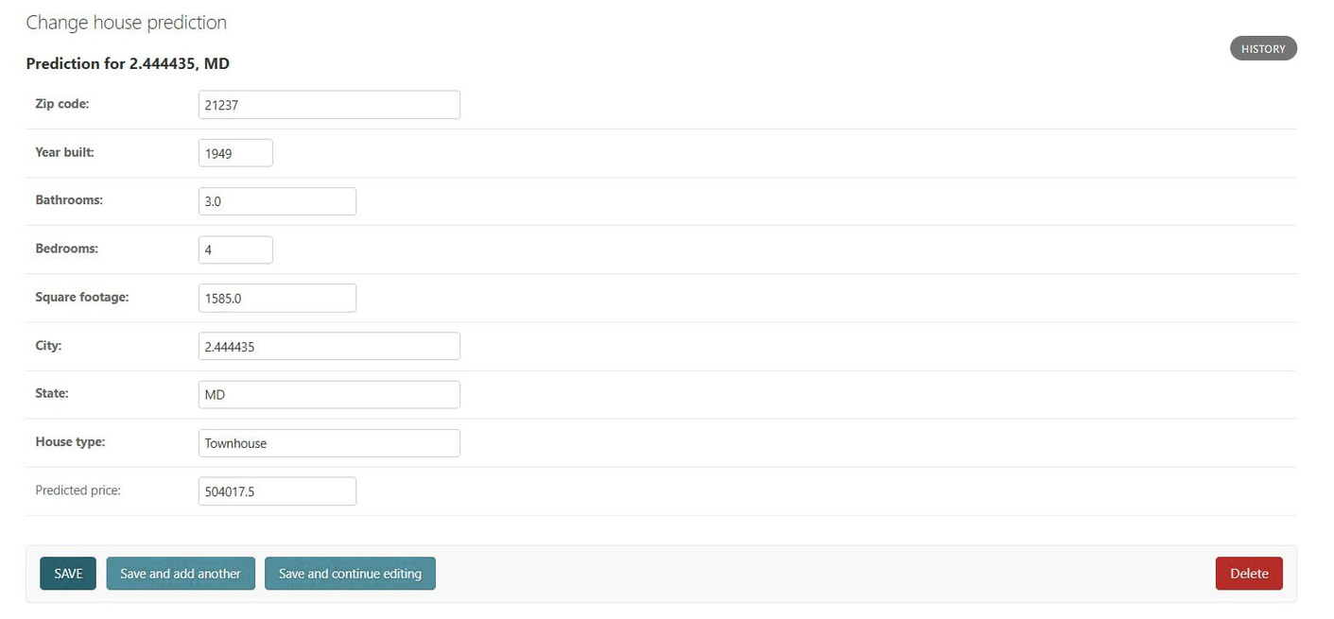
Deployment
Django admin panel:

Slide 19

Final Results & Observations
House Size was the most influential feature in predicting property prices, followed by State and City — confirming that both physical size and geographic location significantly impact house value.
Bathrooms and Bedrooms showed the strongest positive correlations with List Price, indicating that more rooms generally increase the value.
The model captured non-linear relationships between features and List Price, which is why tree-based models like XGBoost performed significantly better than Linear Regression.
XGBoost outperformed all models with an R² score of 0.803, indicating strong predictive performance.

Slide 20


Slide 21


